Slide 1
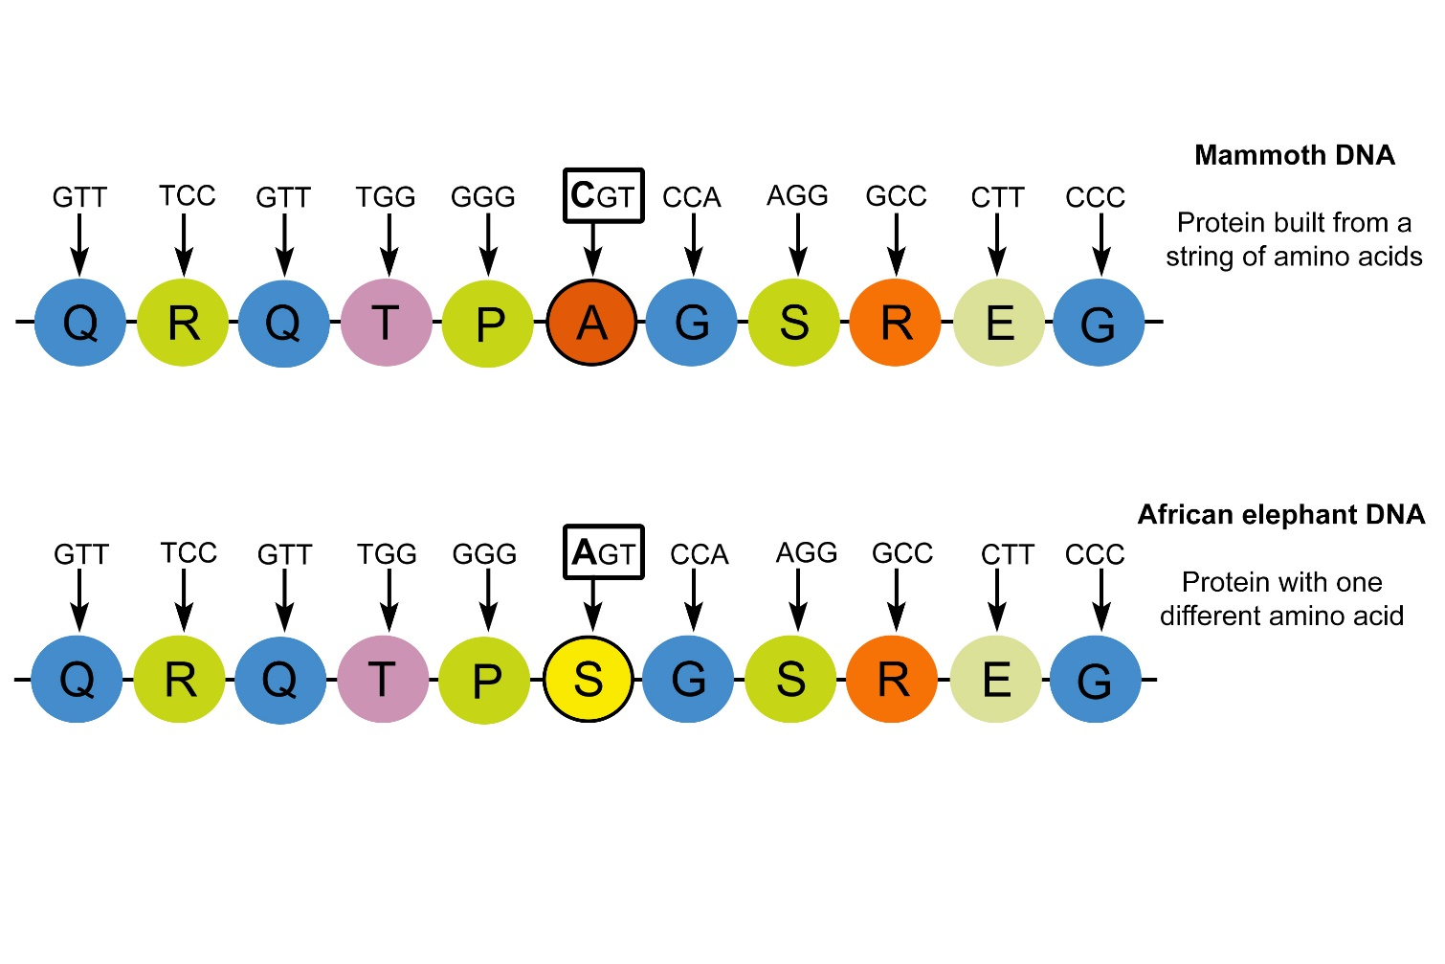
Protein Sequences Provide Evidence for Evolution
Protein Sequences
Bioinformatics
Comparative Genomics

Slide 2
Date: | Human Biology Year 12 ATAR
Do Now Get out equipment Lesson Agenda 1: Do Now 2: DNA evidence for evolution – protein sequences 3: Bioinformatics 3: Lesson summary Suggested Study Read through today’s notes and textbook section NEXT LESSON Fossil evidence for evolution | Learning Aims Review protein synthesis and protein structure Define the term “ubiquitous protein” Describe Cytochrome C Explain why Cytochrome C has changed so little over evolutionary time Describe how Cytochrome C is compared and how similarity is measured to determine common ancestry Describe how other proteins (eg haemoglobin) can be used to provide evidence of common ancestry Define bioinformatics and describe its function Discuss annotation as an aspect of bioinformatics Explore some ways that evolutionary relationships between living things can be represented.
 | Key Vocabulary Ubiquitous Cytochrome C Amino Acid Protein

Slide 3
Genes in DNA code for protein production
Genes are long sequences of DNA base triplets that code for amino acids to be assembled (see picture) into long strands.
These strands fold, and bind, and form specifically structured proteins.
Each human gene codes for between 1 and 3 proteins.
Proteins perform a variety of functions:
Structural material for cells
Control of chemical reactions (enzymes are proteins)
Control of some aspects of membrane transport (as protein channels and/or receptors)
Genes can be switched on or off depending on the cell’s purpose (remember cell differentiation?)
Learning Aim: Review protein synthesis

Slide 4
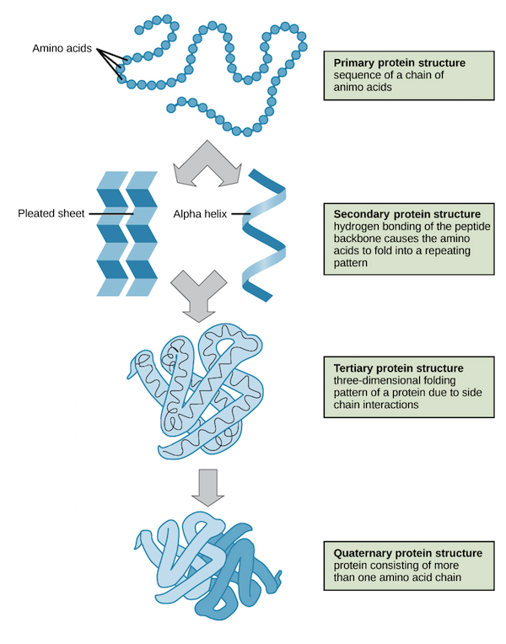
Protein Sequences Provide Evidence for Evolution
Some protein sequences can be compared to assess relatedness and common ancestry among living things, providing evidence for evolution
Proteins
Long chains of amino acids in precise sequences
Amino acids are coded for by base triplets
There are 20 amino acids that form different proteins by being sequenced in different combinations
We can compare specific proteins between species to assess degree of relatedness.
Can look at degree of similarity
Same species almost identical
Degree of difference allows an estimate of amount of evolution since two organisms diverged from common ancestor
Learning Aim: Review protein structure

Slide 5
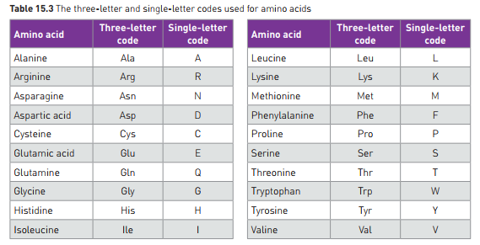
Protein Sequences Provide Evidence for Evolution
Amino Acids and Protein Sequences
Amino acids in proteins are usually represented by 3 letter code
Eg ALA = Alanine
Sometimes given a single letter code as easier to read and compare – see table
Ubiquitous Proteins
Ubiquitous means “everywhere”.
These are proteins that occur in all living things from bacteria to humans
They perform the same function in all organisms
One example is Cytochrome C – essential for cellular respiration
Learning Aim: Define the term “ubiquitous protein”

Slide 6
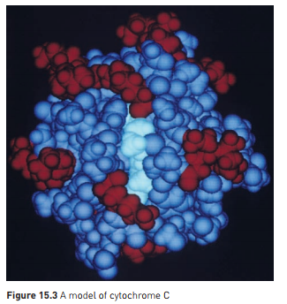
Cytochrome C
Is an example of a ubiquitous protein
Human Cytochrome C has 104 amino acids
37 of the amino acids in Cytochrome C are found in every molecule sequenced, from bacteria to humans
Performs essential step in cellular energy production
Has changed little over millions of years of evolution (why?)
Strong evidence that the genes for Cytochrome C production originated from a primitive microbe ancestor, more than 2000 million years ago
Learning Aim: Describe Cytochrome C and explain why it has changed very little over evolutionary time

Slide 7
Comparing Cytochrome C
Comparing Cytochrome C
Aligned so maximum number of positions with same aa can be determined.
More similarity = more recent common ancestor
Eg: Cytochrome C of chimpanzees, gorillas and humans is identical
Recent divergence from common ancestor
Cytochrome C of Rhesus monkeys differs from humans by one aa.
Still recent divergence from common ancestor, but not as recent as for great apes.
Other proteins provide similar evidence
Eg: haemoglobin is not ubiquitous but is found in all mammals. In humans and chimps, the aa sequence for haemoglobin is identical. It differs by one aa from gorillas, and from gibbons by 2.
Learning Aim: Describe how Cytochrome C is compared and how similarity is measured to determine common ancestry.
Learning Aim: Describe how haemoglobin can provide similar evidence.

Slide 8
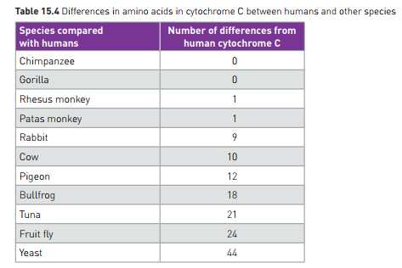

Slide 9
Bioinformatics
Bioinformatics
Combines biological science, computer science, stats and applied maths to understand and model biological processes
Use of computers to describe and analyse living things at a molecular level
Has assisted evolutionary biologists to trace evolution by measuring changes in DNA
Recent developments allow comparison of entire genomes
“annotation” – identification of genes and other biological features – an aspect of bioinformatics
Identifies base sequences of individual genes within the genome.
Does this by identifying Start and Stop codons where sequences begin and end.
Does not discover what these genes do, just labels them for later analysis.
Done by computer once genome has been sequenced – most genomes are too large to be annotated by hand
Learning Aim: Define bioinformatics and describe its function. Discuss annotation as an aspect of bioinformatics.

Slide 10
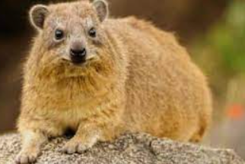
Comparative Genomics Summary
Genome sequences of different species are compared.
Eg ERVs, mtDNA, known gene locations and sequences, ubiquitous proteins etc.
Identifies regions of similarity and difference.
Can ID genes that are preserved, and those that provide individual characteristics and differences
Has observed a high degree of similarity between closely related organisms, and diversity in different evolutionary lineages.
Has resulted in reclassification of some species, as the evidence shows a slightly different relationship than was originally hypothesised.

Slide 11
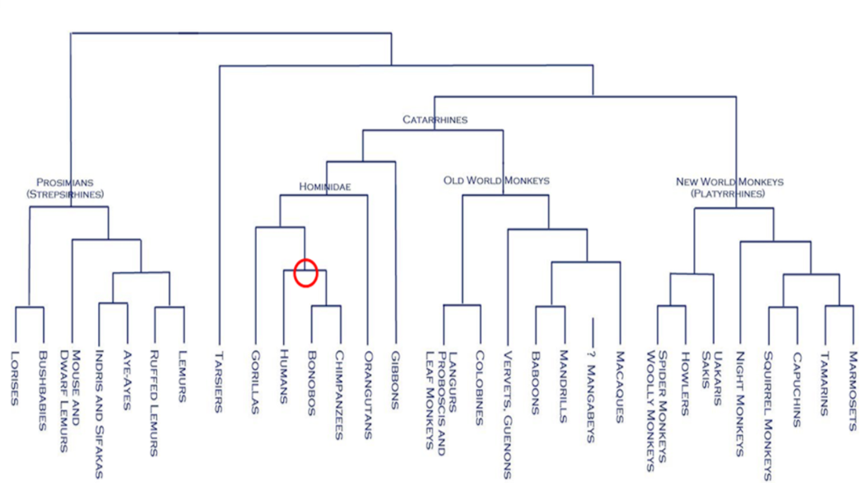
Learning Aim: Explore some ways that evolutionary relationships between living things can be represented

Slide 12
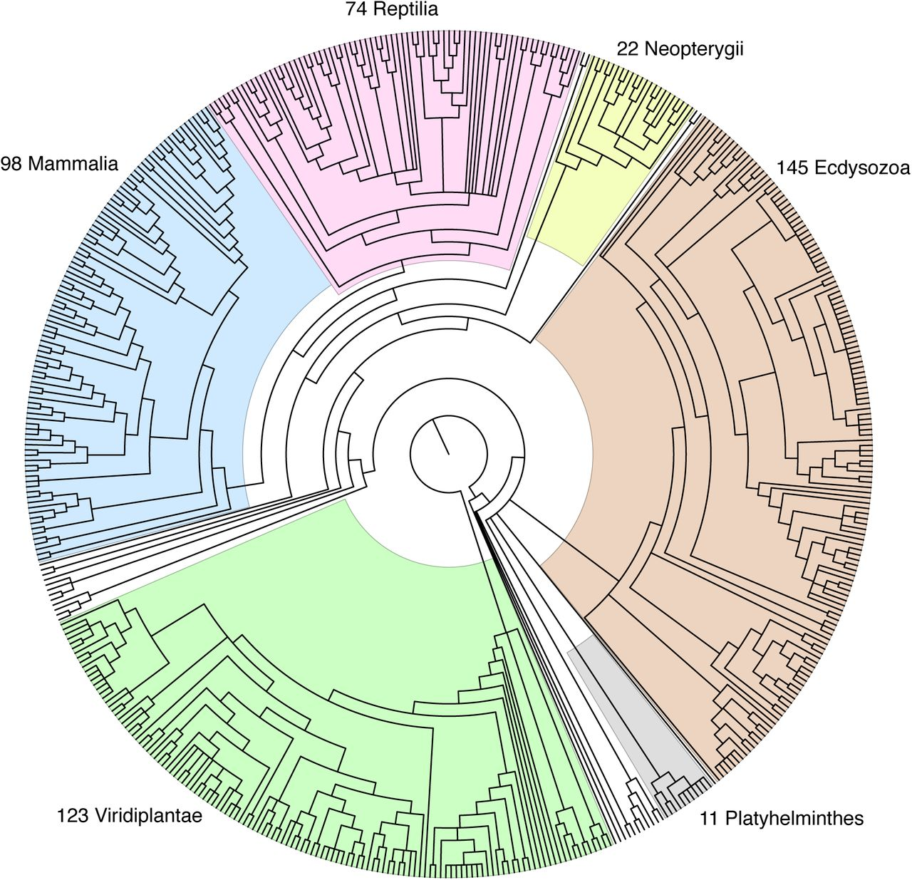
Learning Aim: Explore some ways that evolutionary relationships between living things can be represented

Slide 13
Tree of Life Explorer Website: https://www.onezoom.org/
Learning Aim: Explore some ways that evolutionary relationships between living things can be represented

